Slide 1
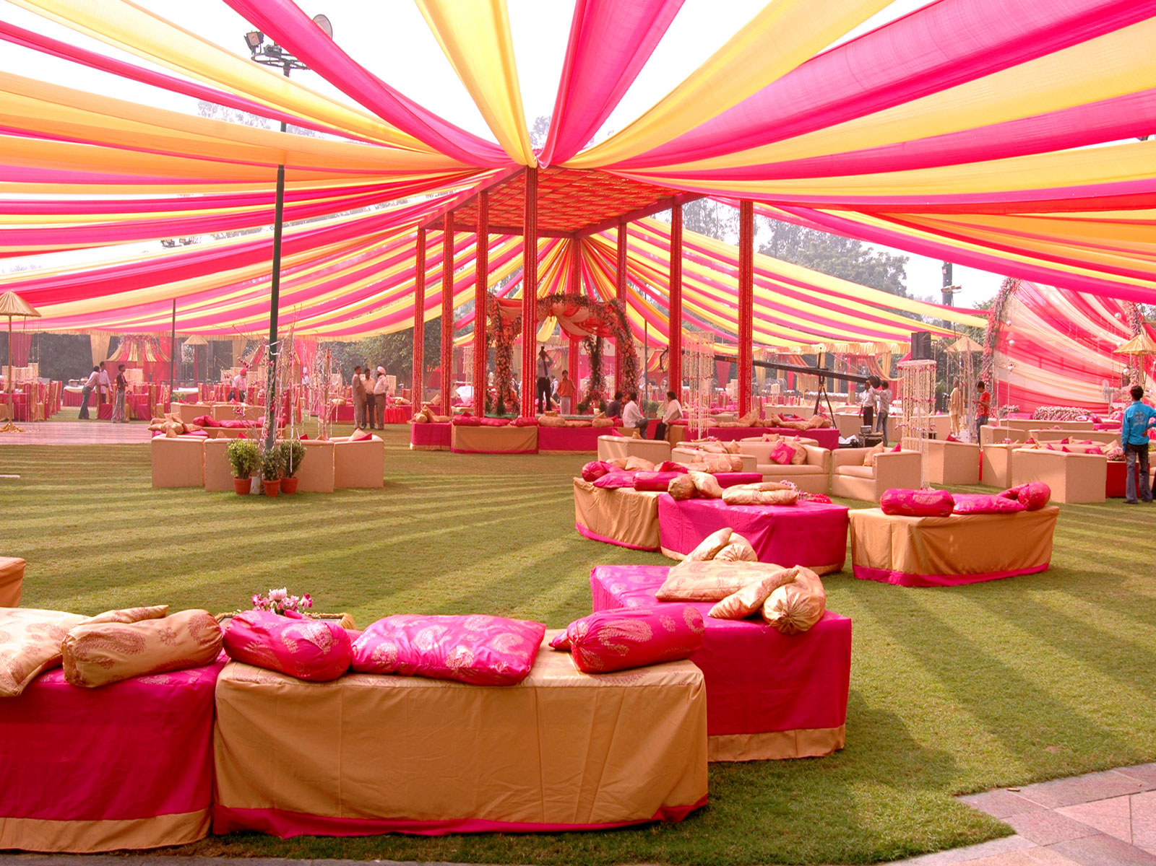
Bharat tent house
NAINITAL

Slide 2
ABOUT US
Established in 1991 by Mr. Kanhaiya Lal Sah in Nainital.
Specializes in wedding planning, convocation, exhibitions, conferences, election management, trade fairs as well as religious and cultural fests.
Currently branched as Nav Bharat Tent House in Bhowali, Celebration and Sangam in Haldwani and Sai Lights in Bhowali.
Our goal is to deliver cost effective service without compromising on the quality.

Slide 3
SERVICE
Wedding event management.
Personal event management.
Party venue booking service.
Ceremony management service.
College function services.
Back stage management.
Stage setap servies.
Party organizers.
Reception event management.
School event organizers.

Slide 4
OUR SERVICE
Waterproof tent
Pipe pandal
Bengali chunat gate
Dome
High class crockery & Cutlery
Canopy stall
Octonorm stall
Convocation

Slide 5
Major Clients
We have been working with various departments over the years. Some of our major clients are as follows :
Kumaun University
Organizing the University's convocation since the past 3 years.
Government Events
Setting and arrangement of the Governors Golf tournament.
Government inaugural events.
Religious and Cultural fests
Nanda Devi Fair Trade
Nainital Winter Carnival
Yog Mahotsav, Jageshwar
Almora Winter Carnival

Slide 6
Schools and colleges
Saint Joseph's College, Nainital
All Saints College, Nainital
Sherwood College, Nainital
Graphic Era Hill University, Bhimtal
Nancy Convent, Jeolikote
Ashoka Hall, Ranikhet
G.D.Goenka, Naukuchiatal
Birla Institute of Applied Sciences.

Slide 7
Convocation Don
Convocation Don
Convocation Don

Slide 8

Gallery

Slide 9

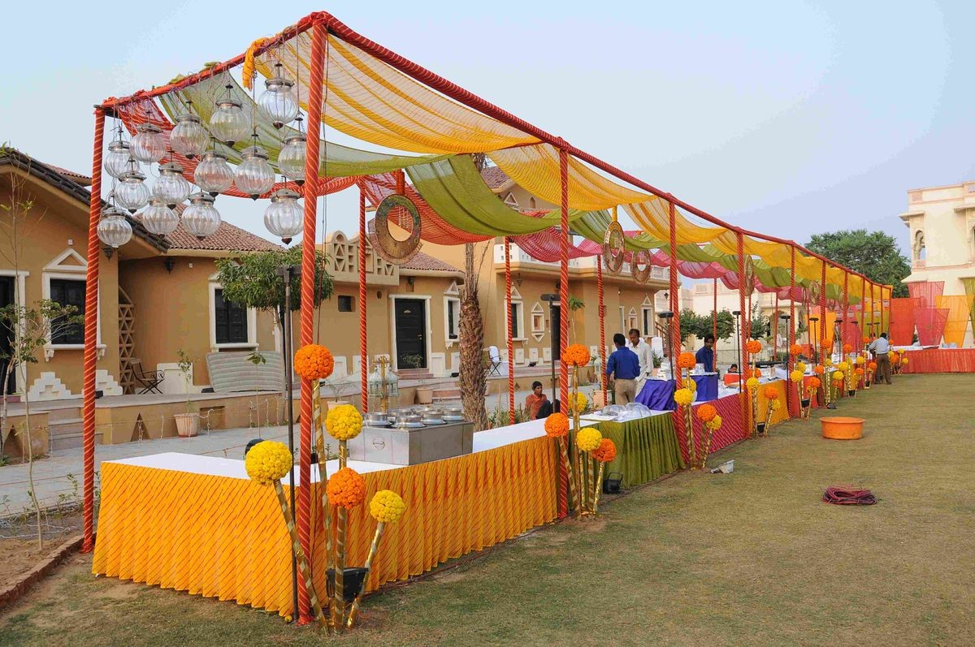
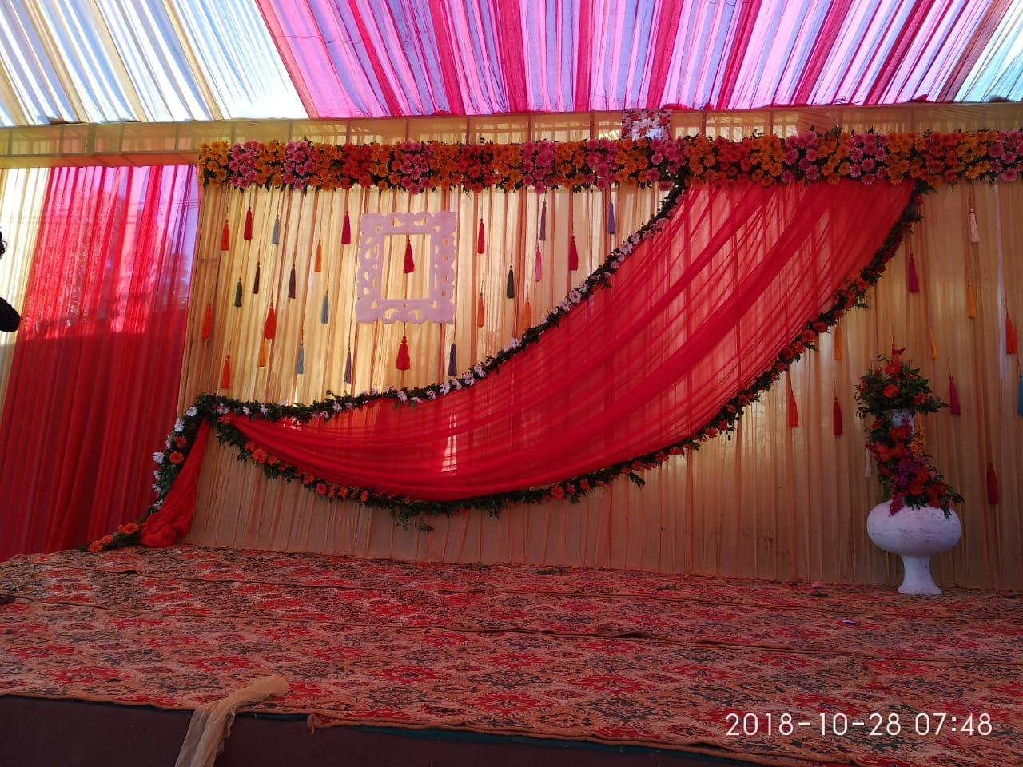
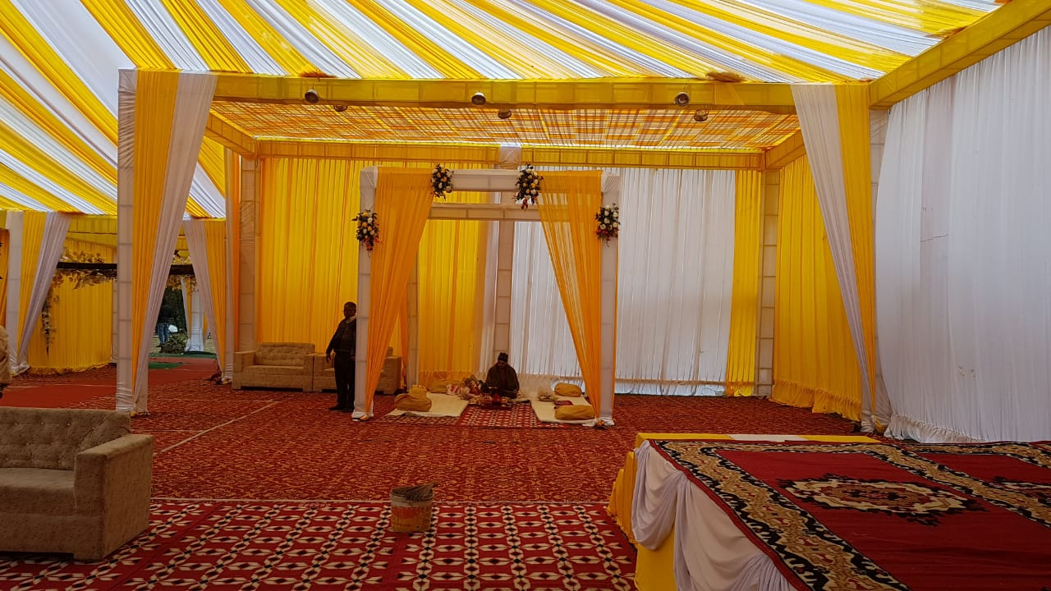
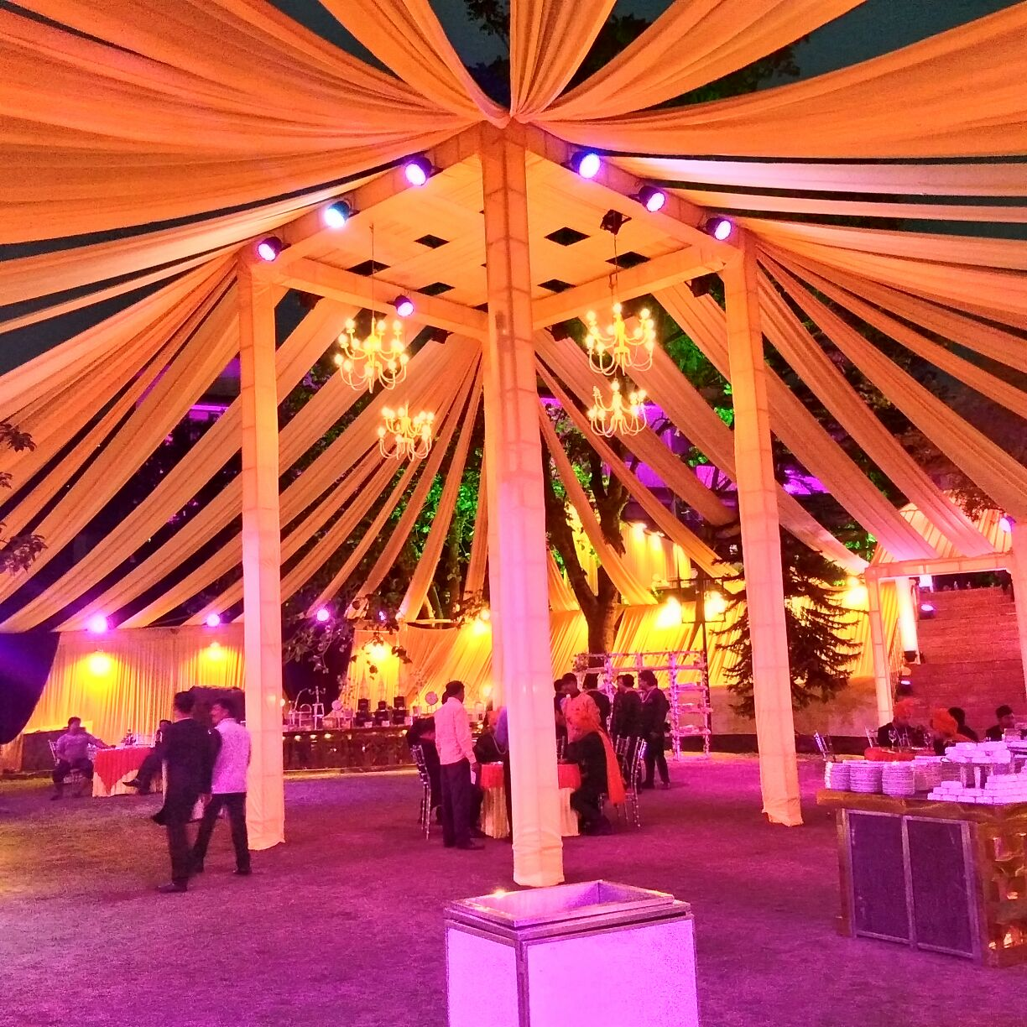

Slide 10
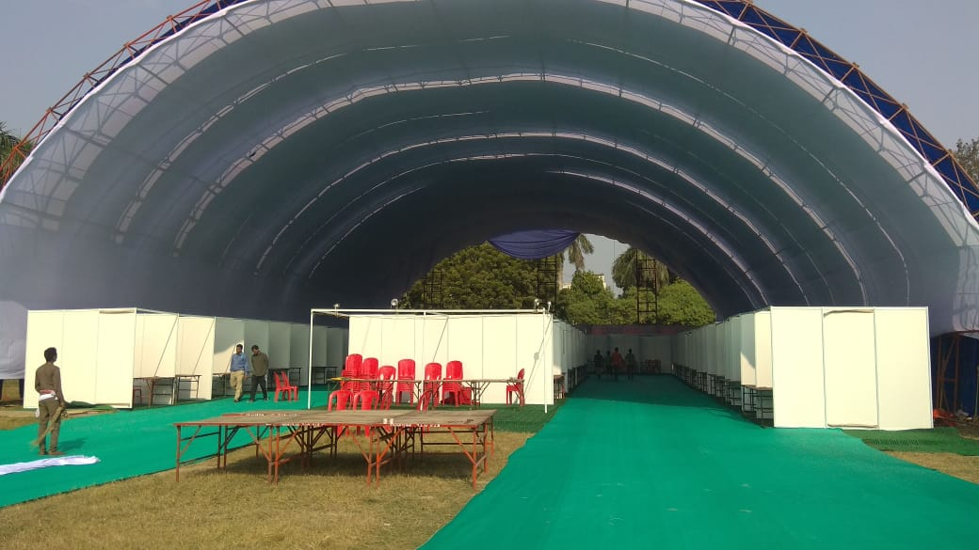
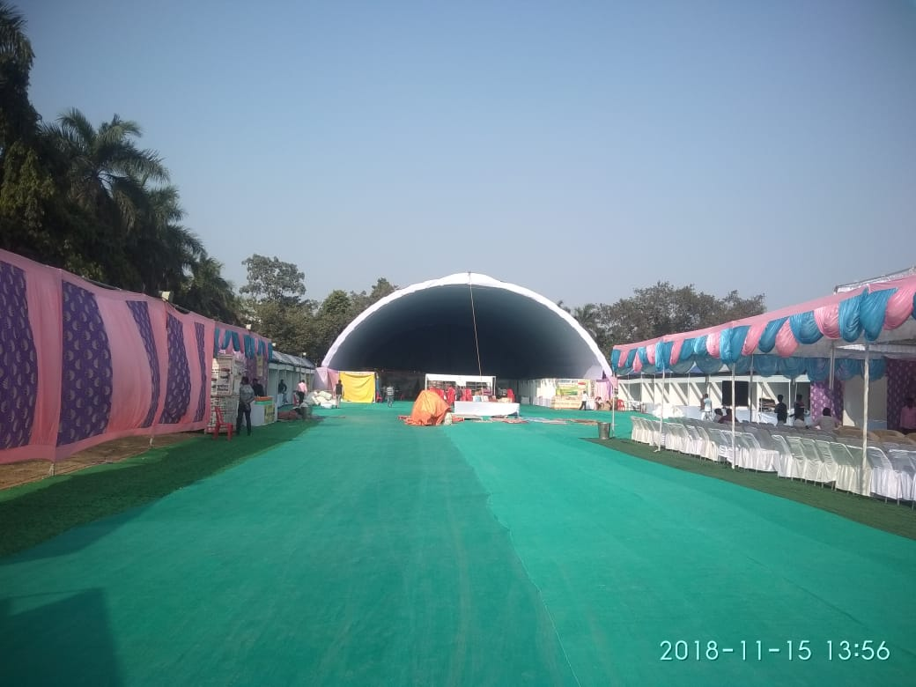
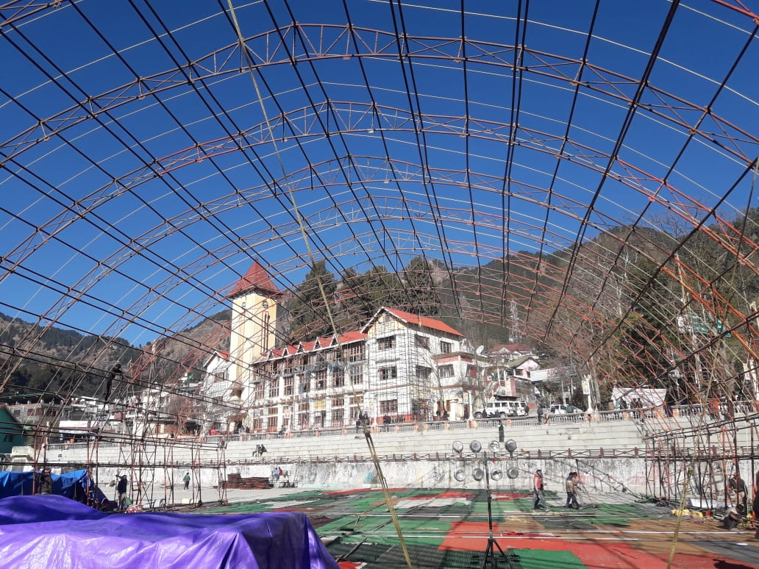
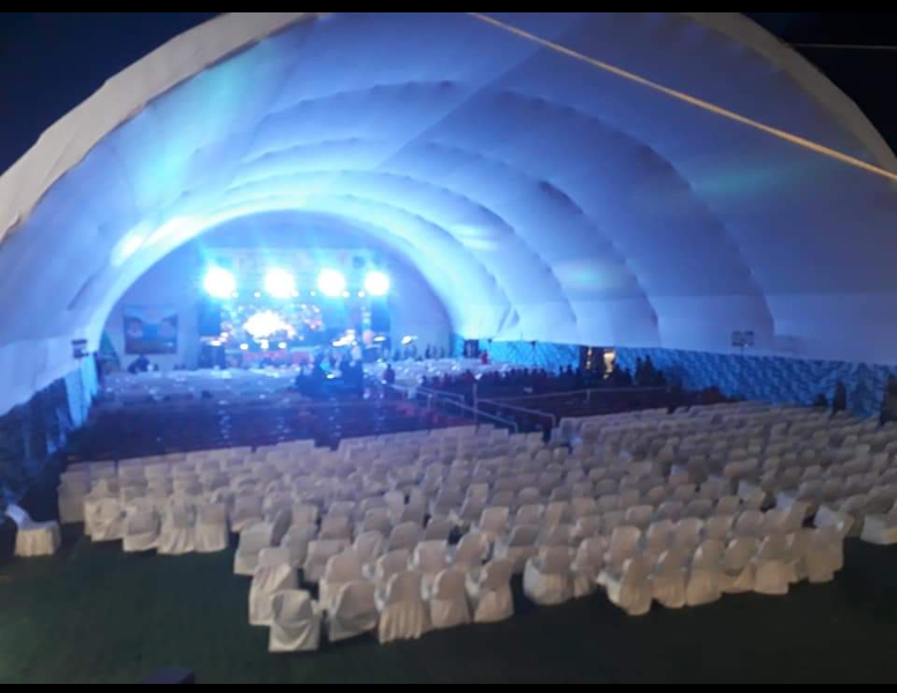

Slide 11
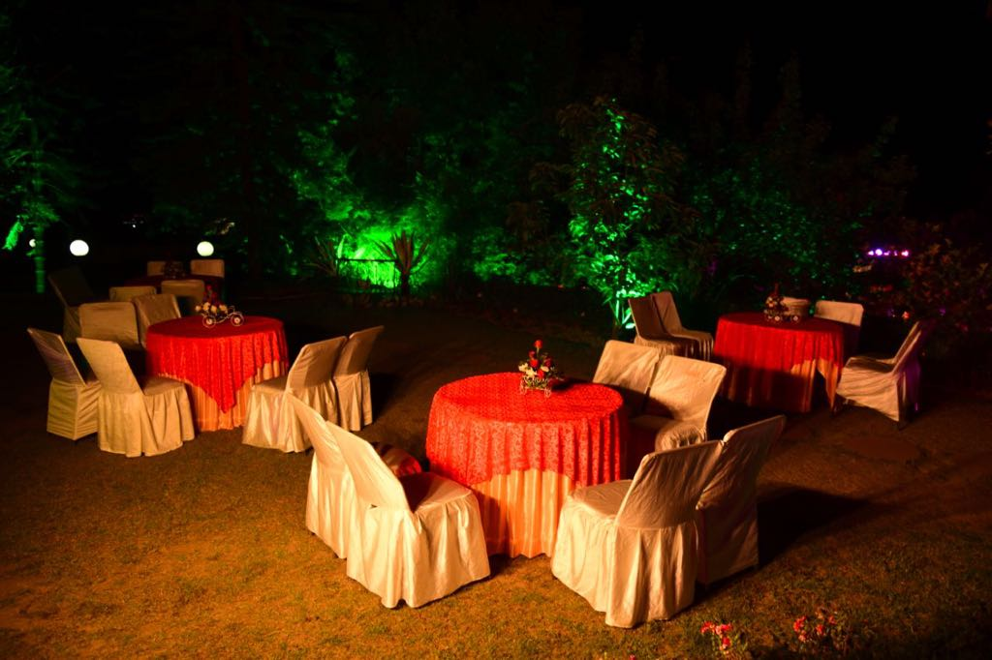
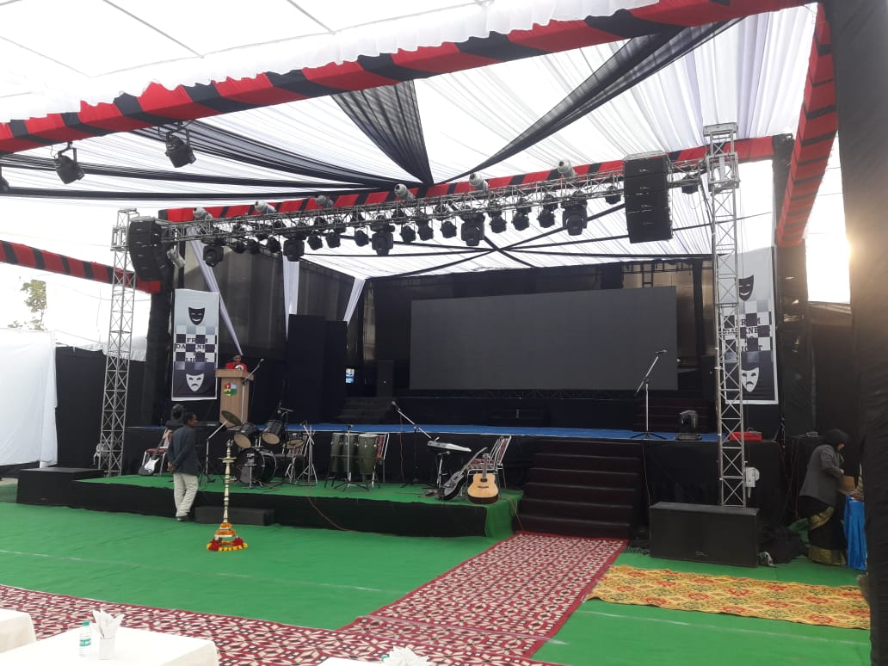
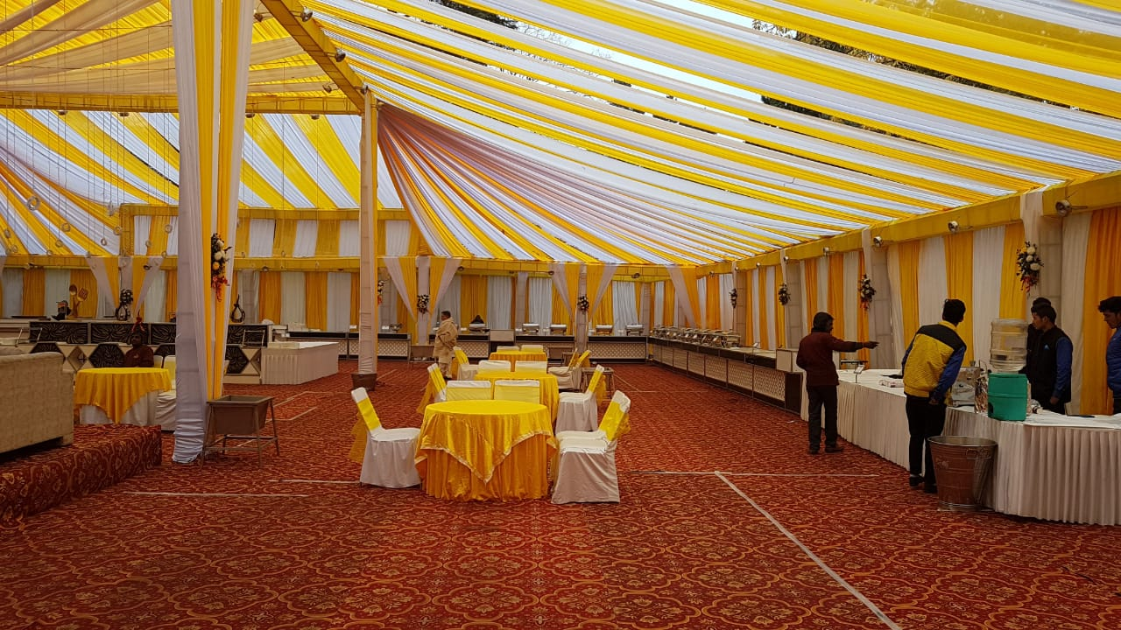
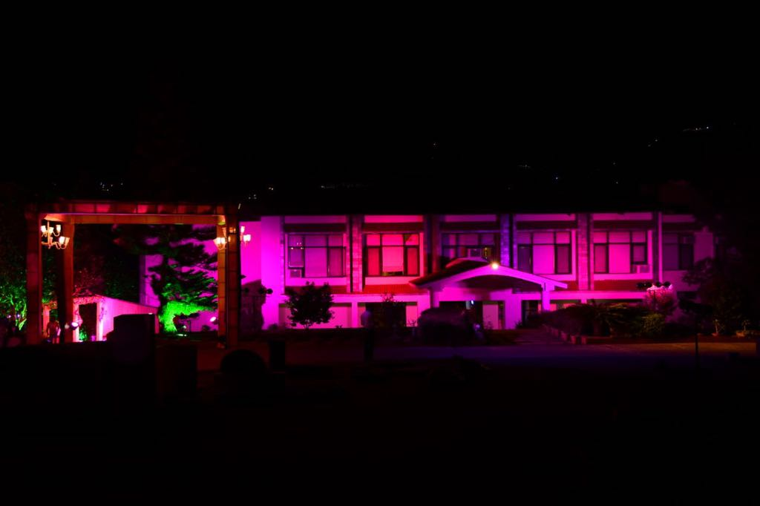

Slide 12
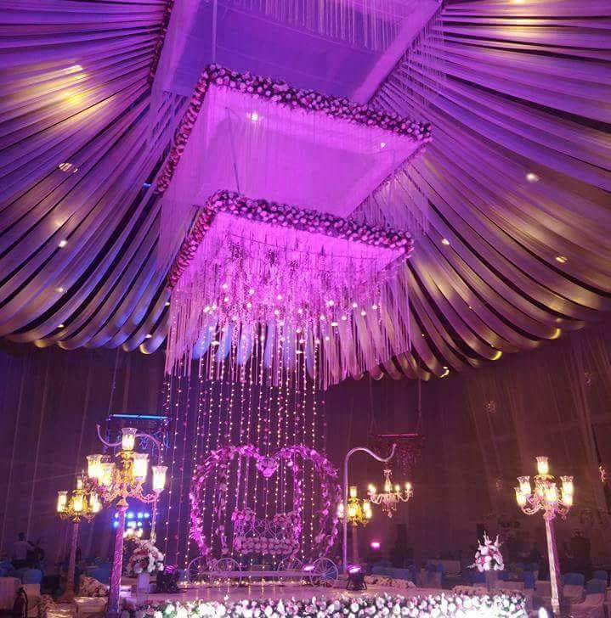
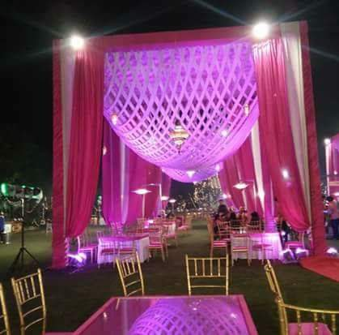
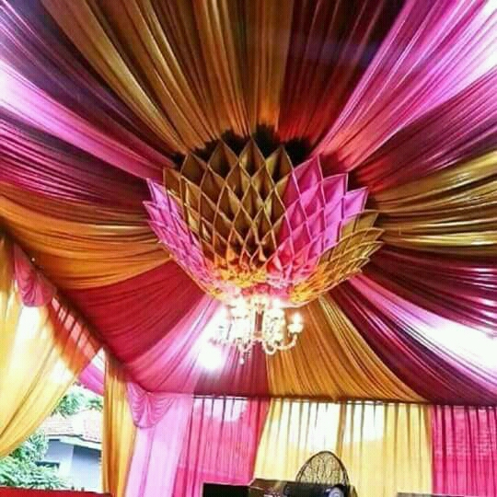
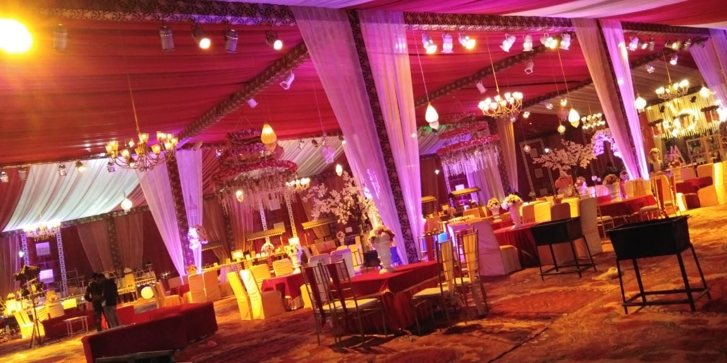

Slide 13
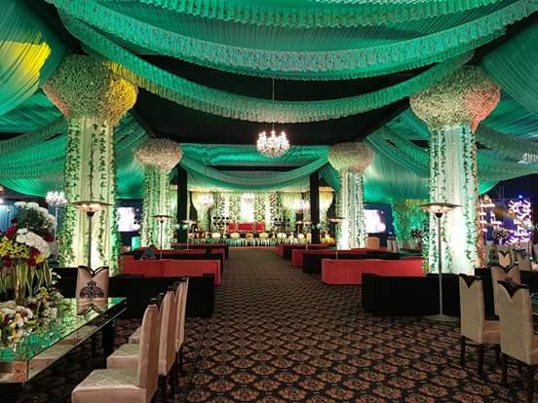
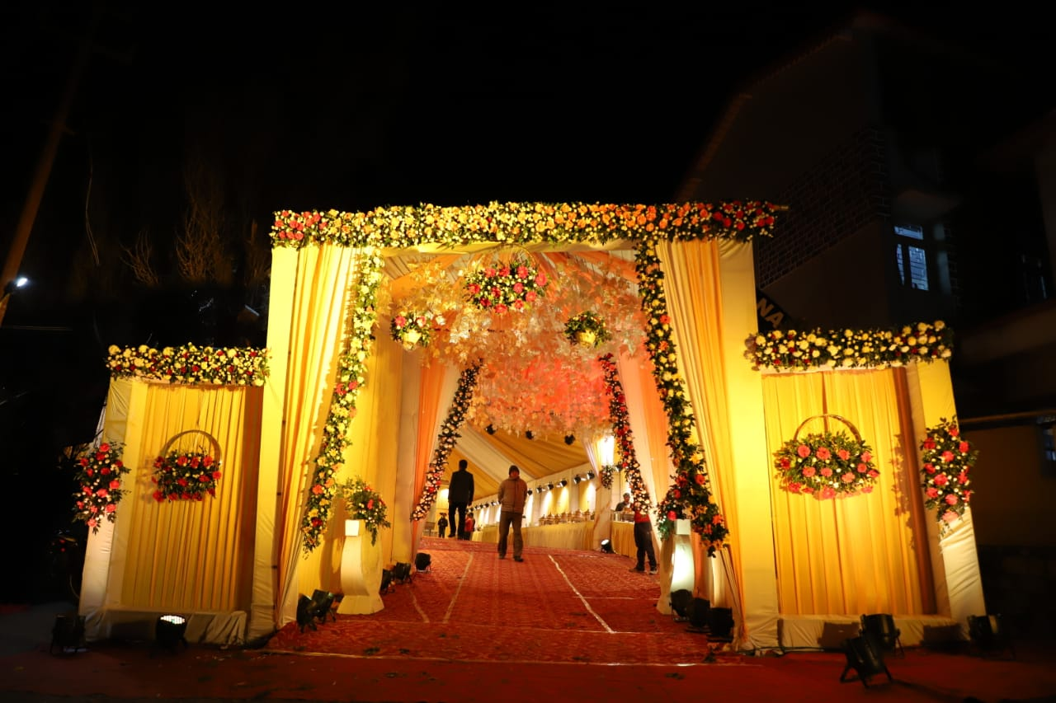
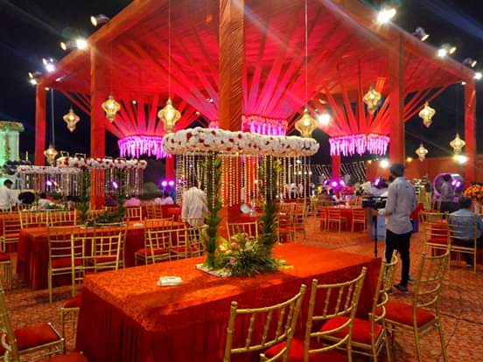
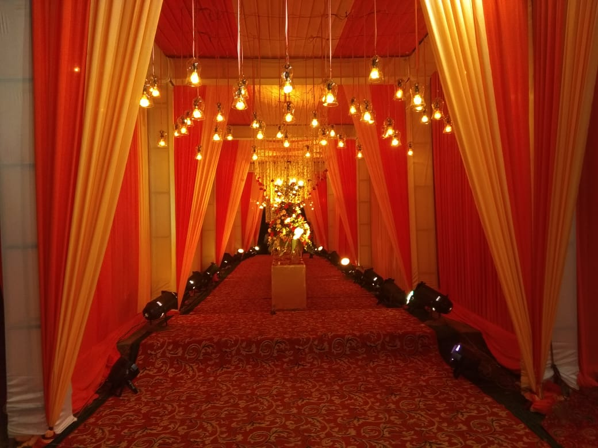

Slide 14
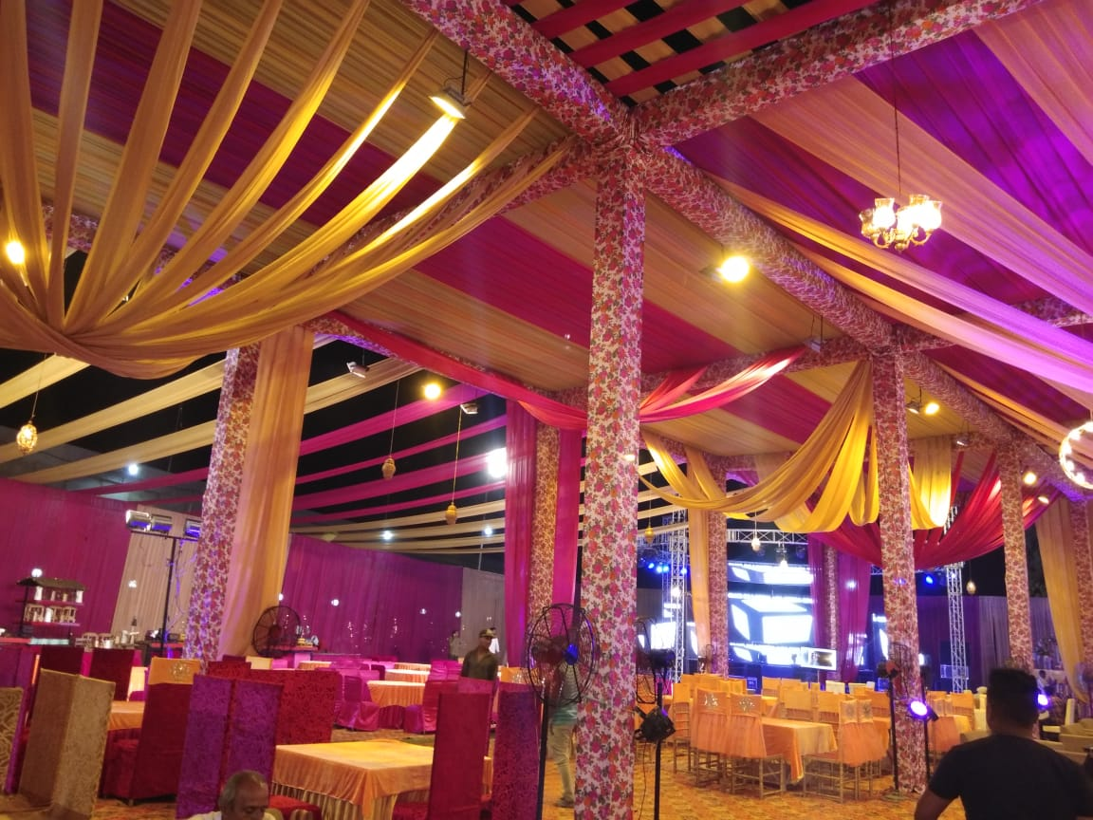
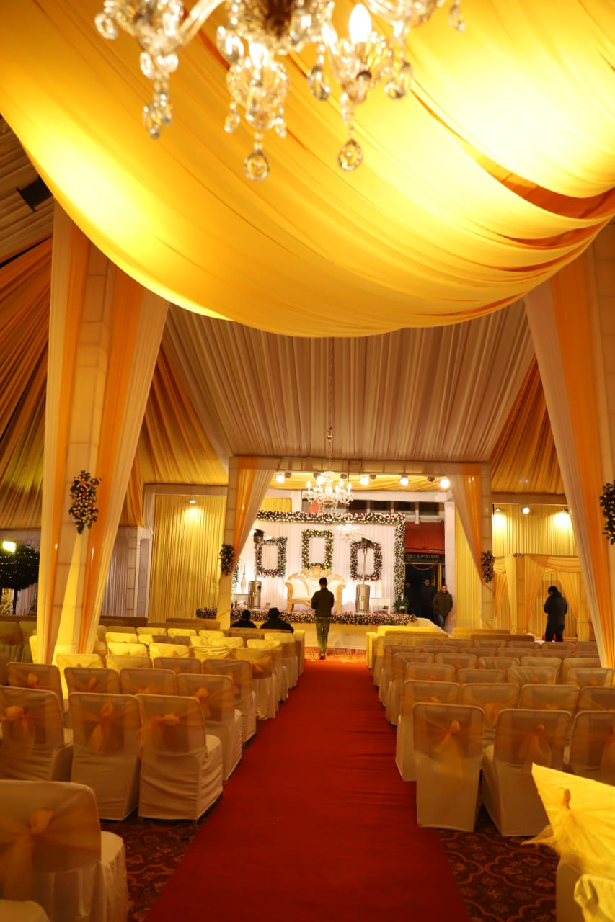
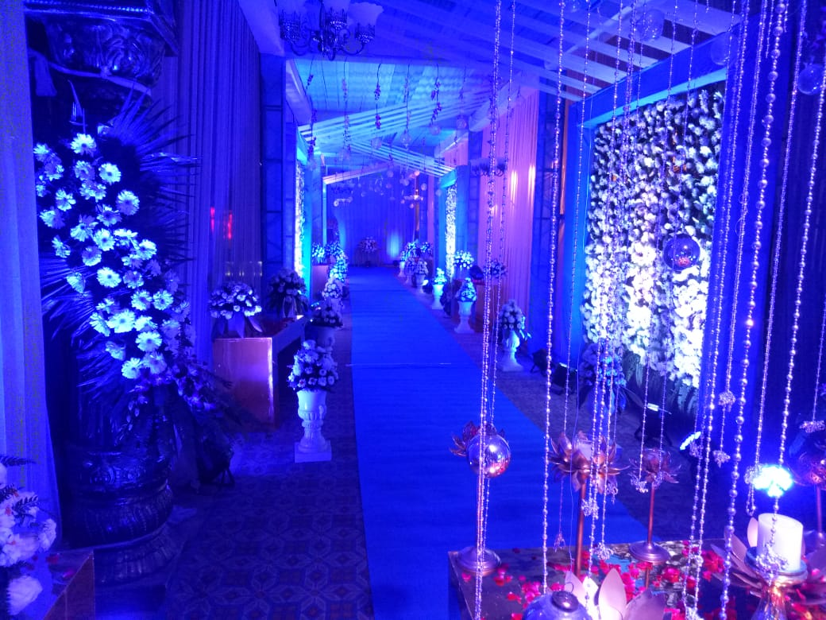

Slide 15
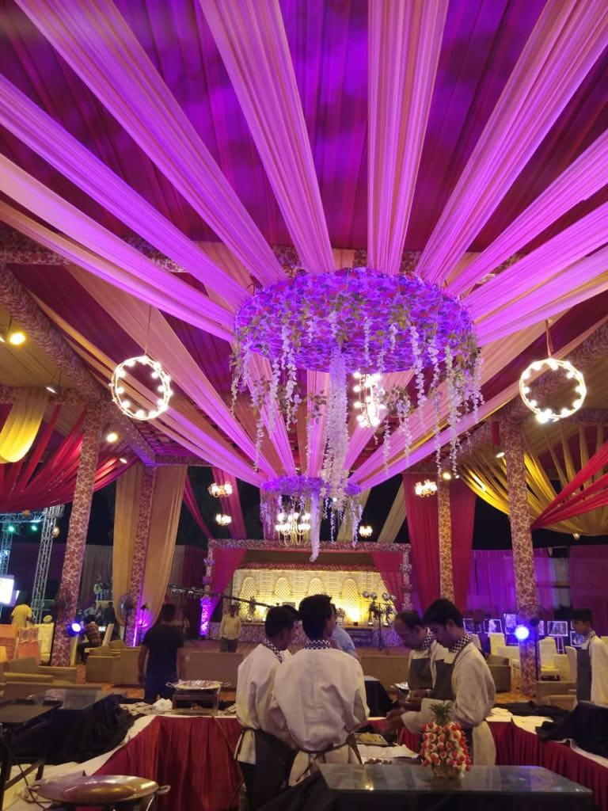
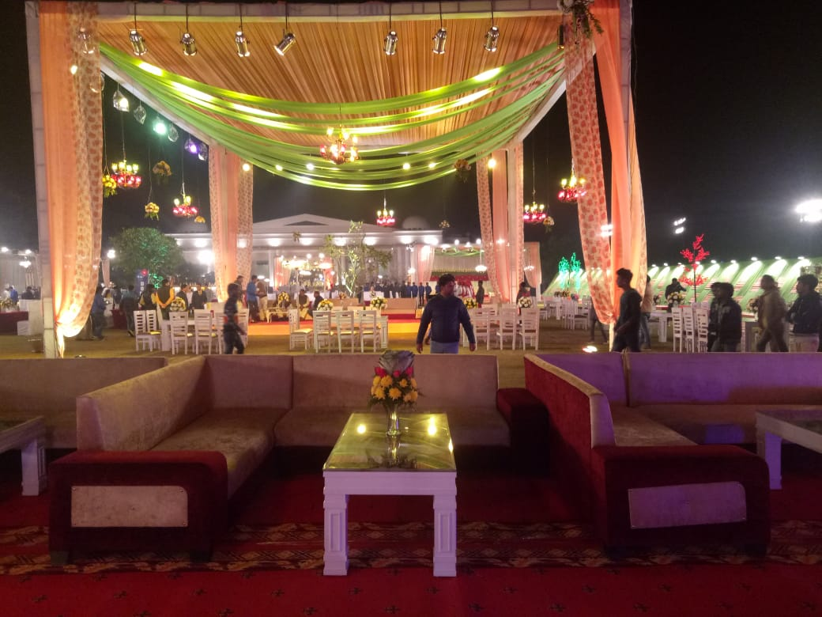

Slide 16
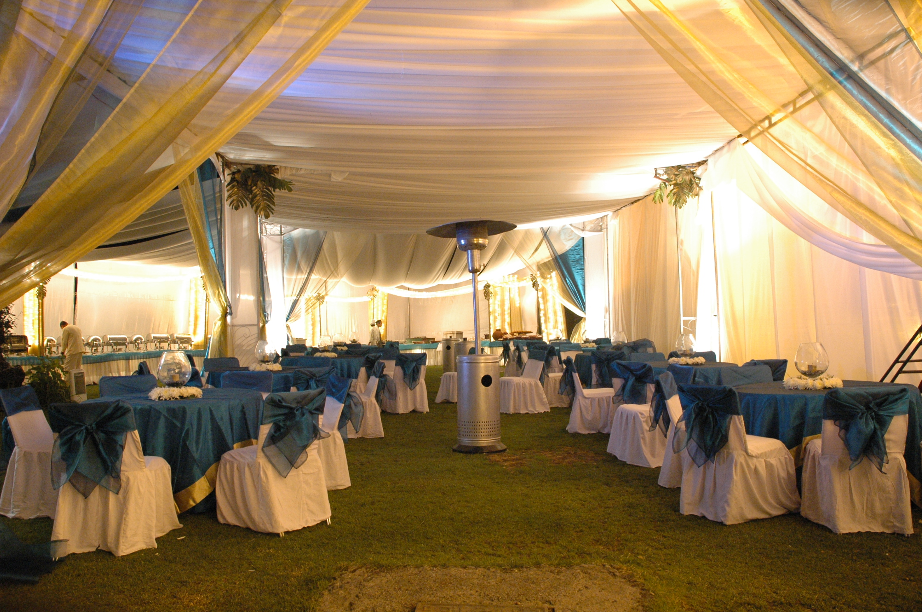
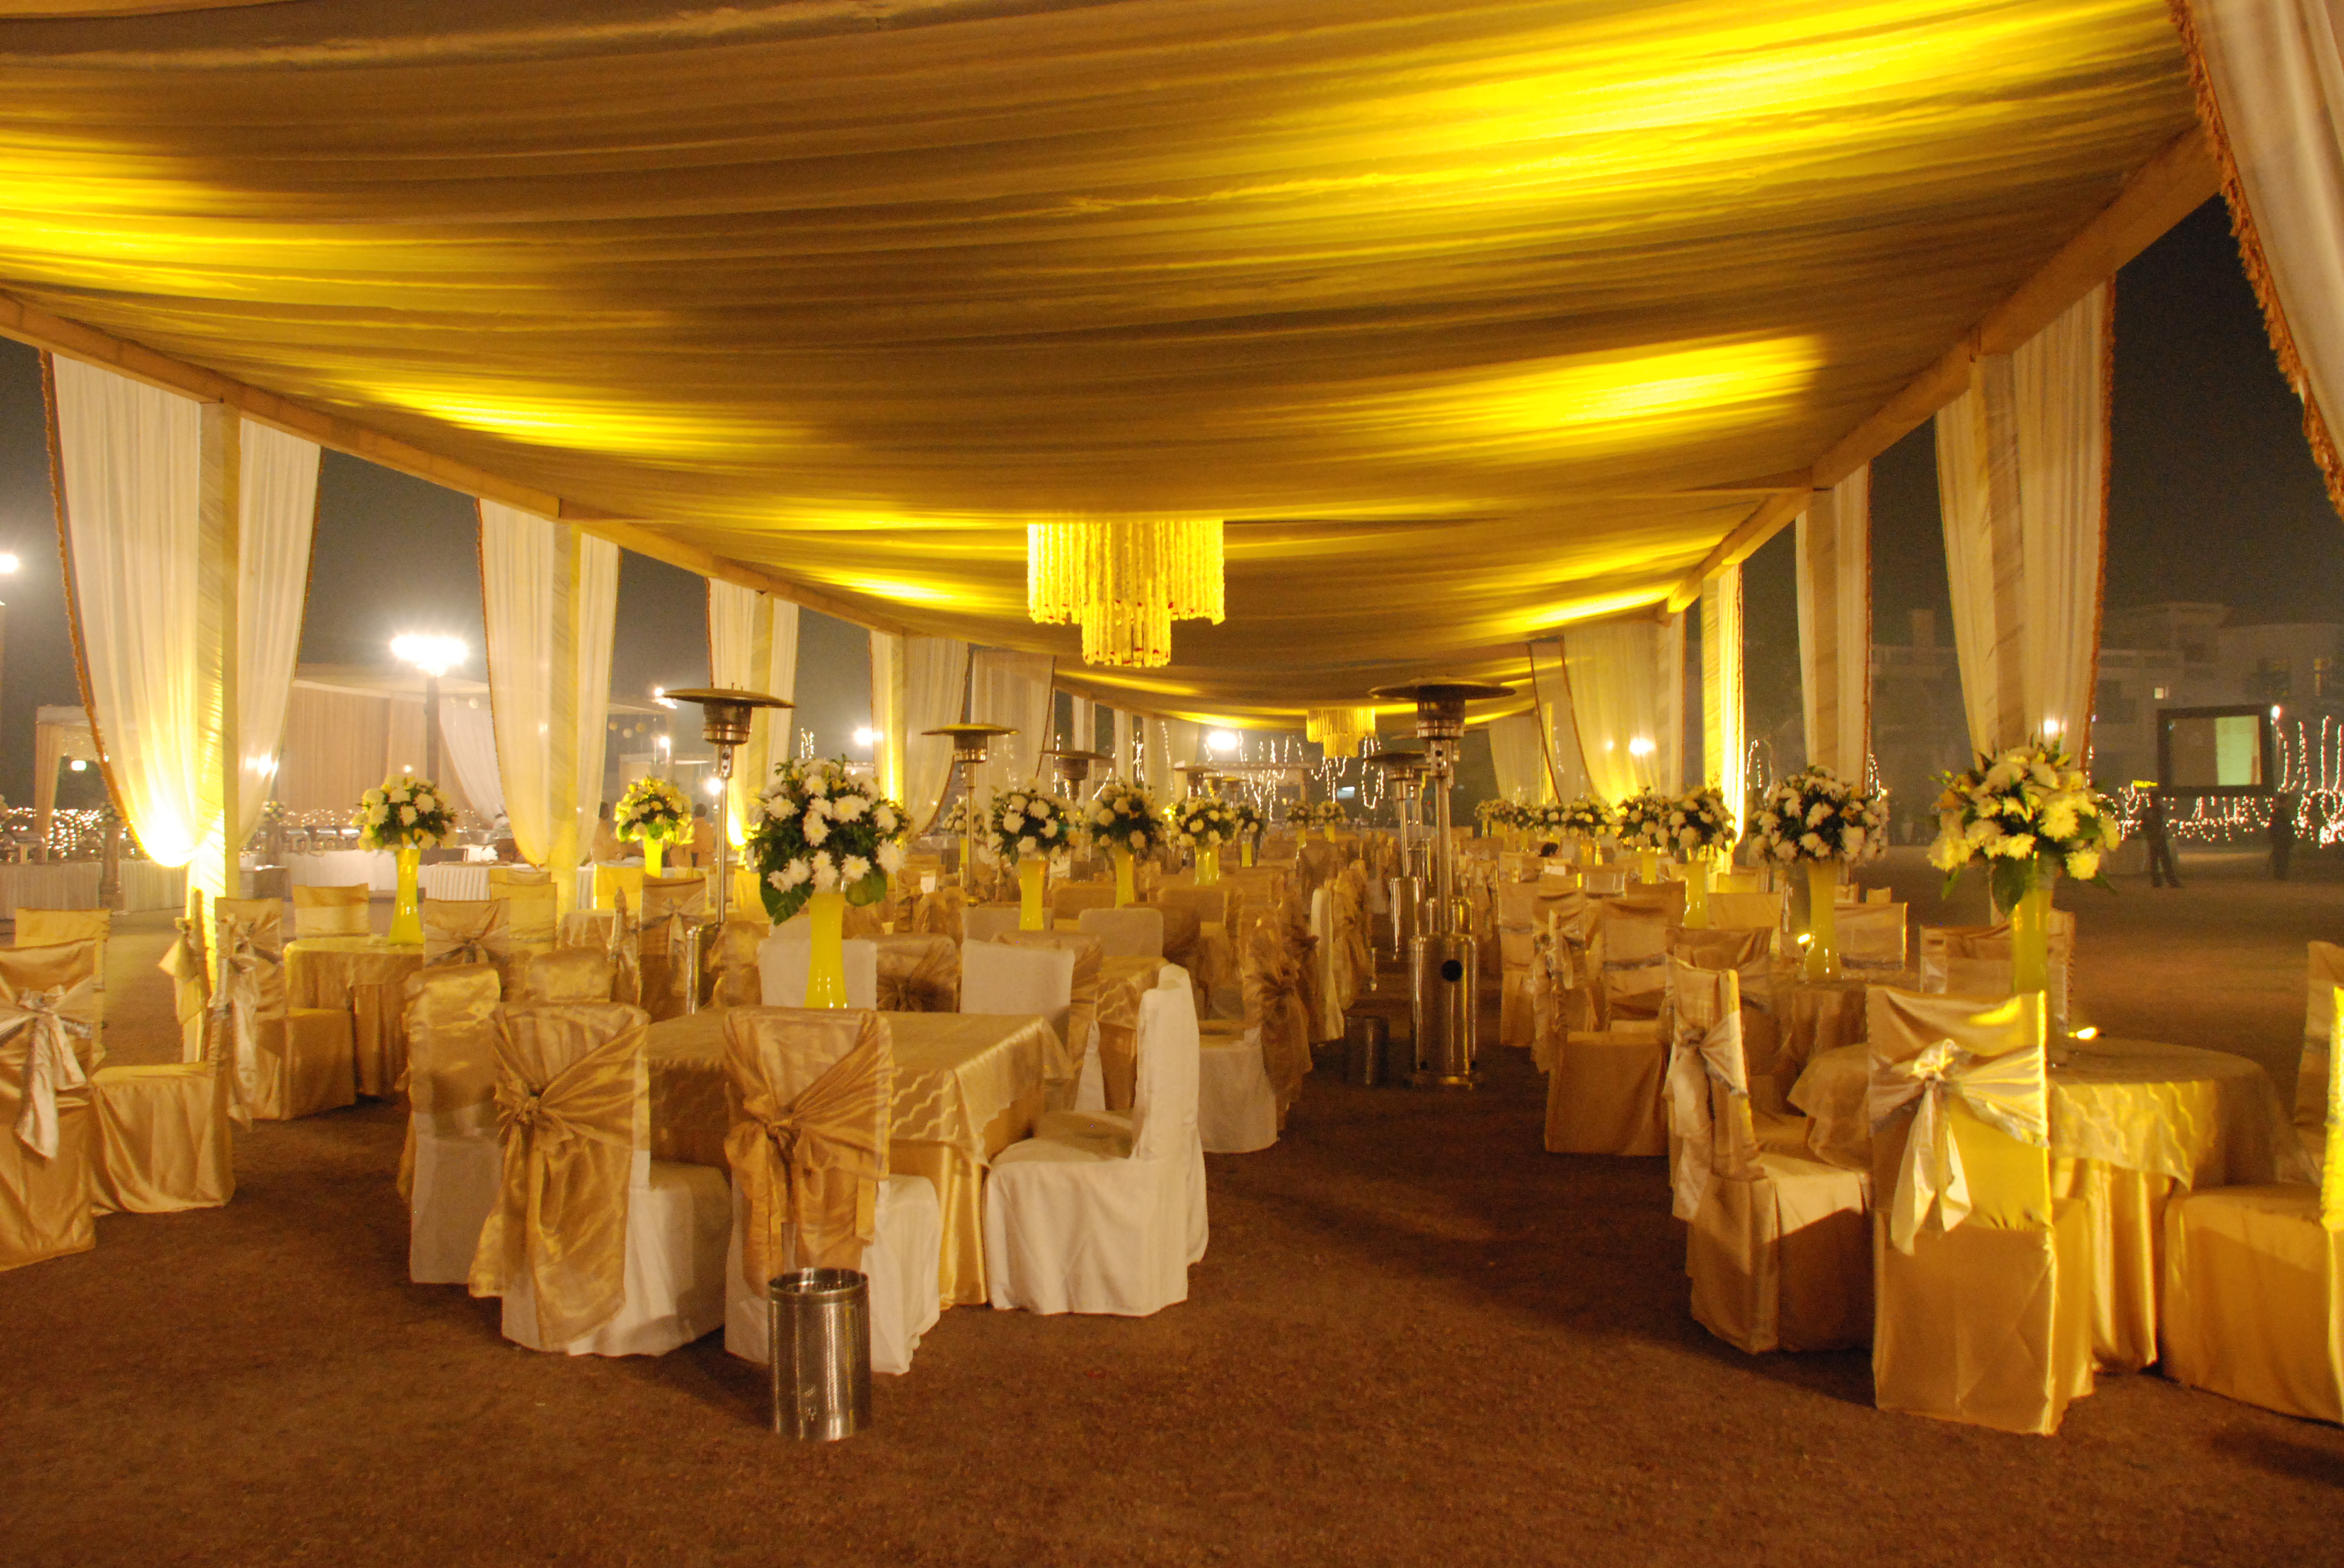

Slide 17
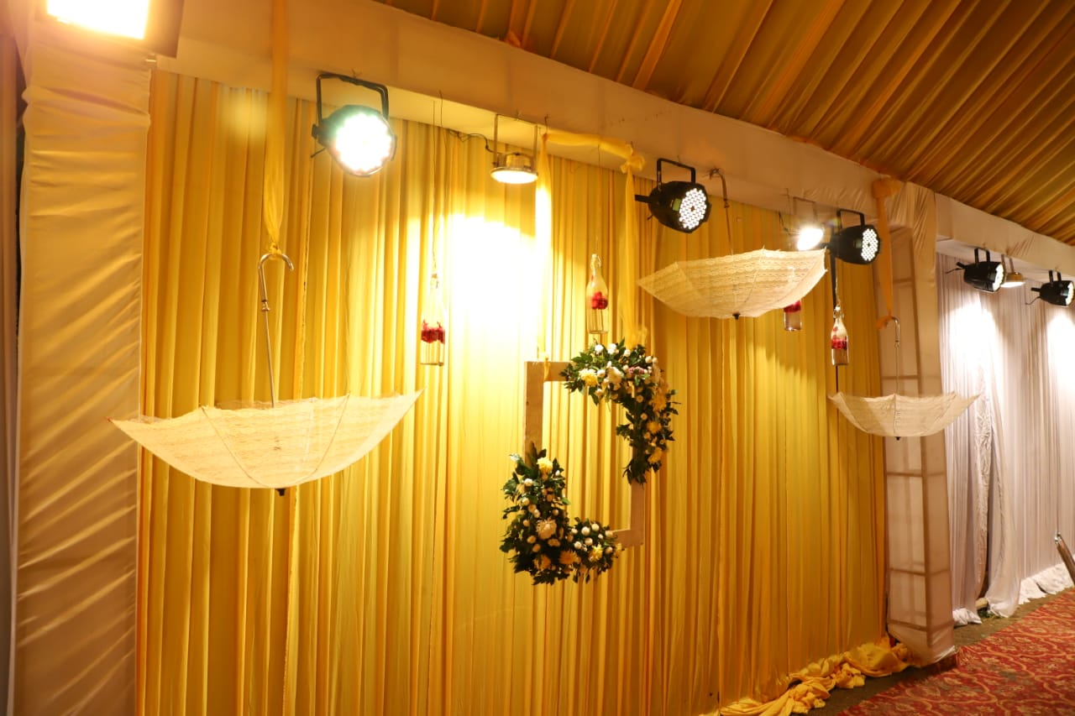
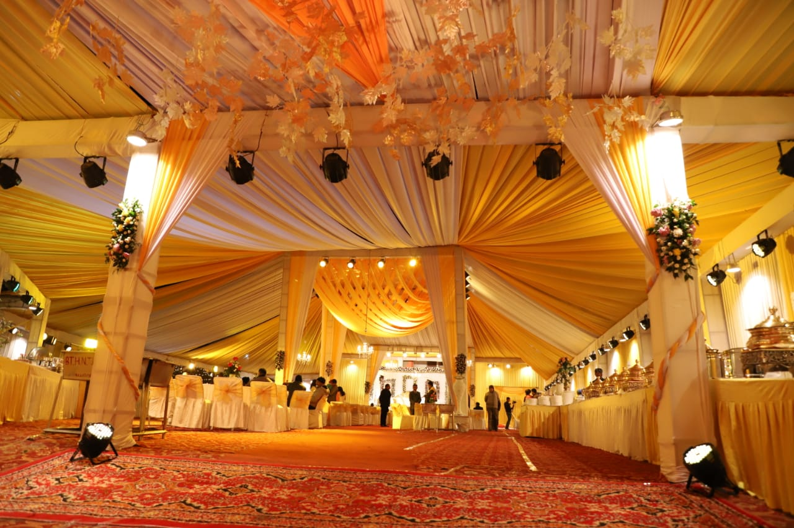

Slide 18
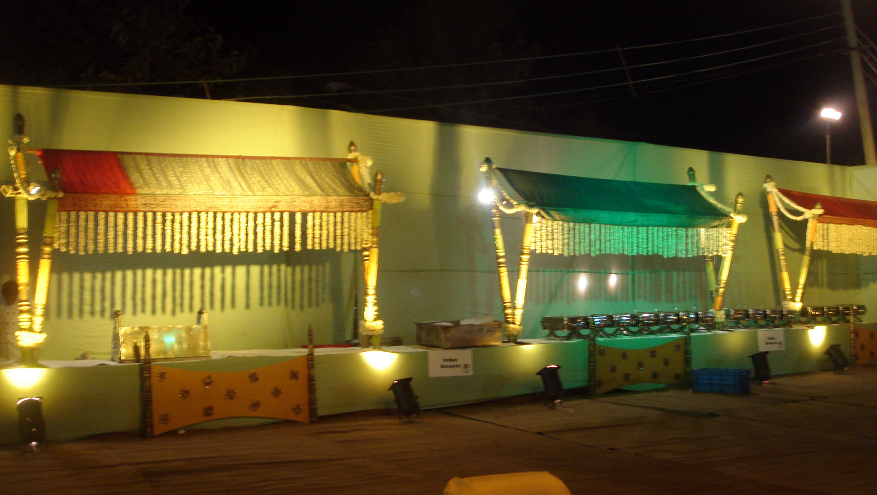
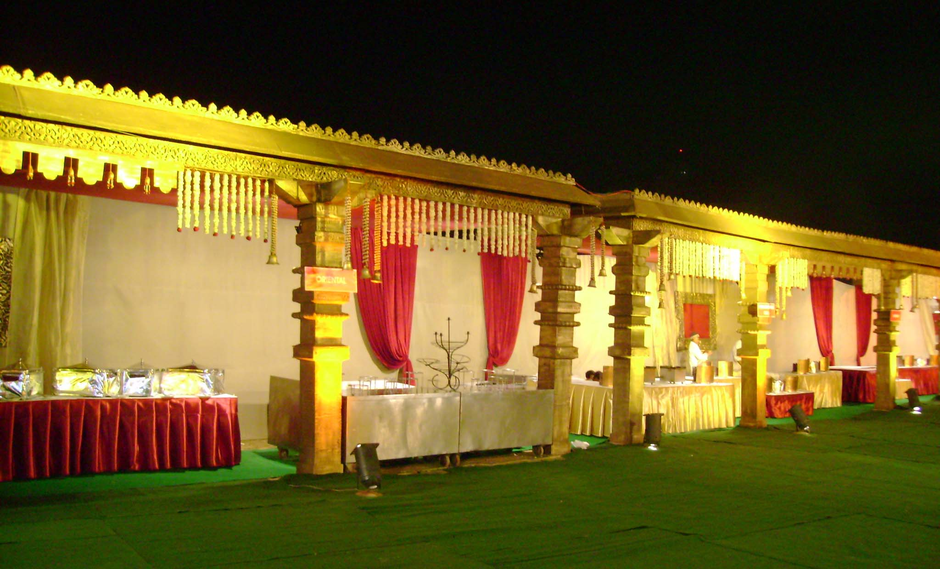

Slide 20


Slide 35
CONTACT US
devvratsah@gmail.com
+91- 9412084146, 8884368668, 9412979301

